Slide 1
JIRA
Bhagyalaxmi Nair
18-03-2019

Slide 2
Document Control
<Client>
Engagement Revision History
Date | Version | Author | Brief Description of Changes |  |  |  | Approver Signature
18/3/2019 | 0.1 | Bhagyalaxmi Nair | Initial version |  |  |  | Rajesh Gawade
18/3/2019 | 0.1 | Bhagyalaxmi Nair | Incorporated Review Comments |  |  |  | Rajesh Gawade

Slide 3
Table of Contents
Introduction
Features of JIRA
Purpose of the document
Process of uploading the test scripts
Execution process
Defect Creation process

Slide 4
Introduction
<Client>
Traditionally known as the issue tracking tool.
JIRA allows you to track any kind of unit of work through a pre-defined workflow. For e.g.:- issue, bug, story, project, task, etc.
Mainly evolved as a project management tool.
Used to manage Scrum implementation with Agile.
Tool provided by Atlassian.
JIRA unlocks the power of Agile Project Management.

Slide 5
Features Of JIRA
Test management
Issue management: Track and manage issues ,epic,feature,User story,bug.
Search with ease
Dashboards
Workflow management

Slide 6
Purpose of the document
This guide is intended to be read by all users of Jira.
It provides a knowledge on various processes like uploading a test script, execution and defect creation process.
This guide will walk you through each and every necessary steps.

Slide 7
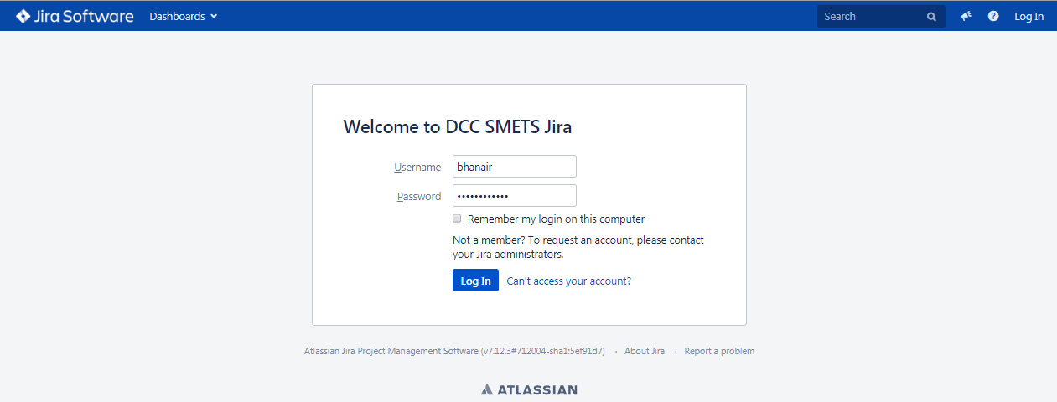
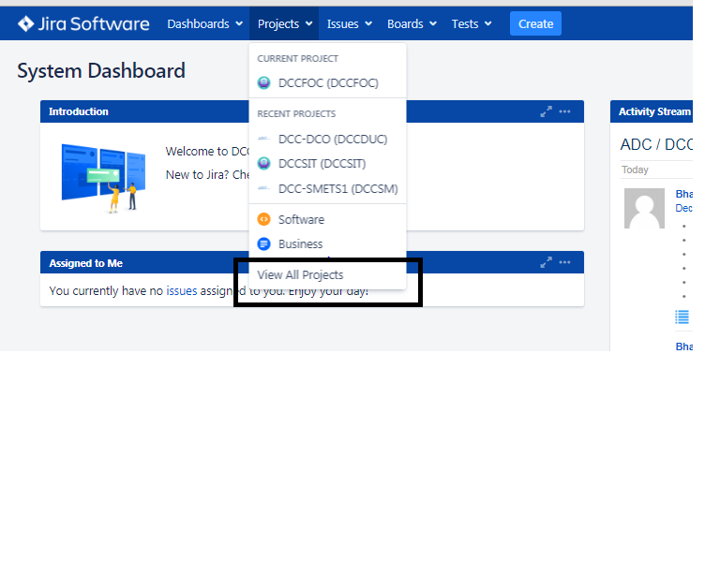
Process of uploading the test scripts
Login into JIRA with valid credentials.
Under Projects tab click on View all Projects

Slide 8
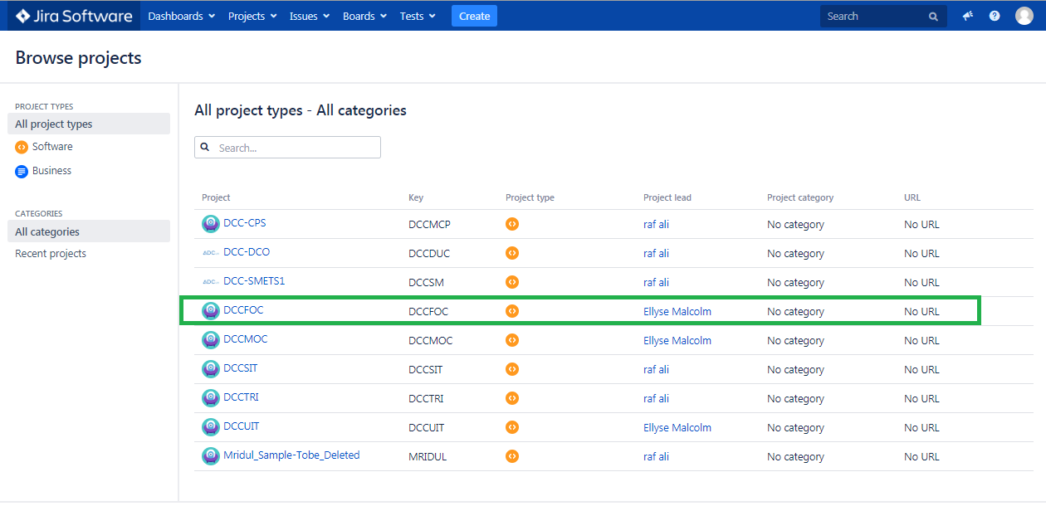
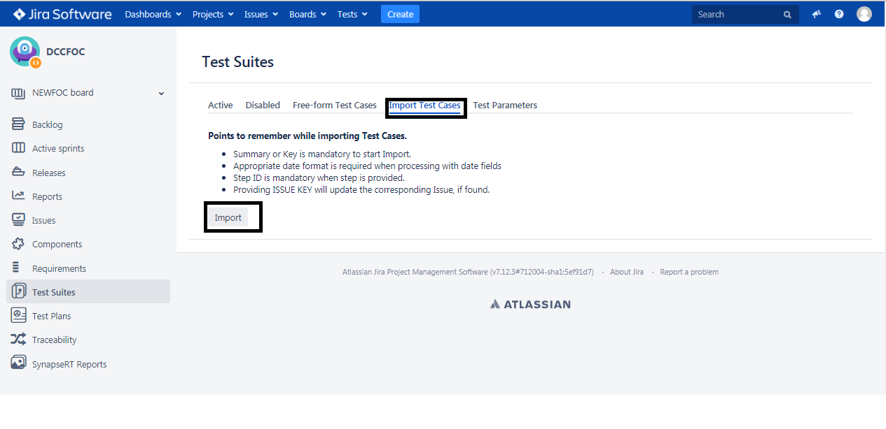
Process of uploading the test scripts
Select the project on which you will be working, for e.g.:- DCCFOC.
Click on the Import test cases tab and the import button.

Slide 9
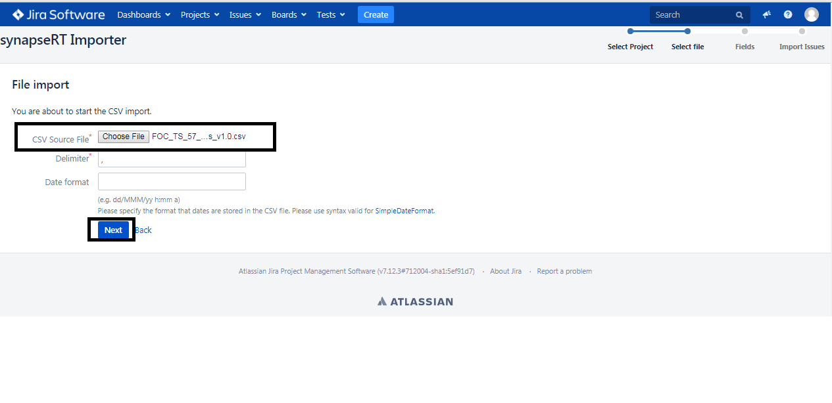
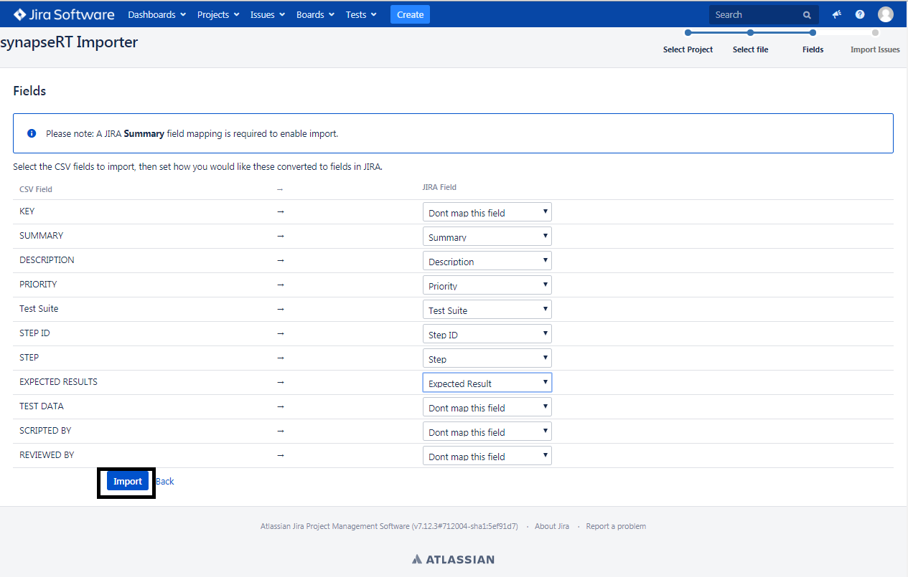
Process of uploading the test scripts
Import the CSV file and click on the next button.
Fill all the JIRA field corresponding to the CSV
field and finally click on Import button.

Slide 10
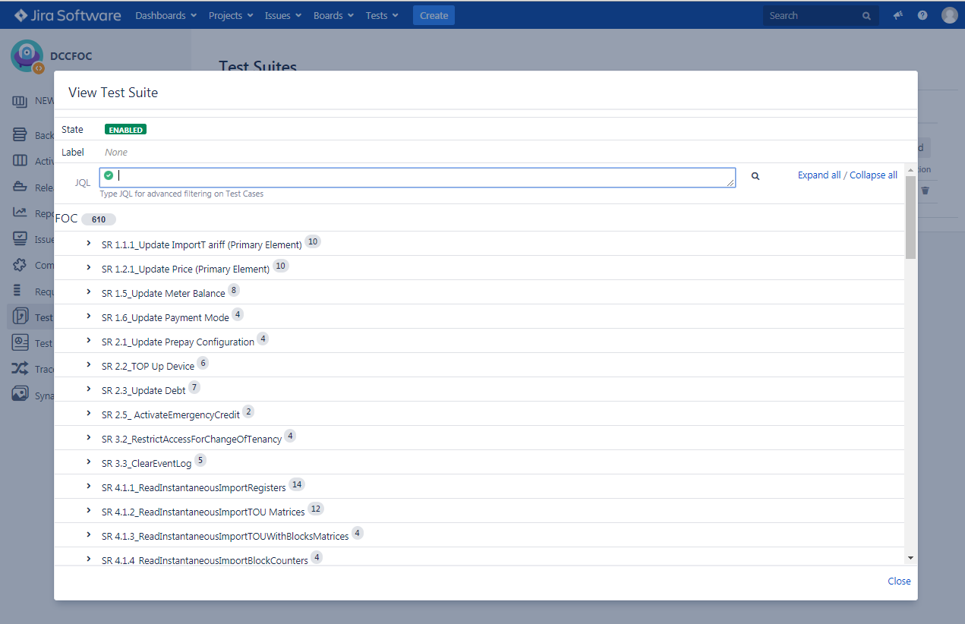
Process of uploading the test scripts
You can view all the test suites that you have uploaded when you click on FOC.

Slide 11
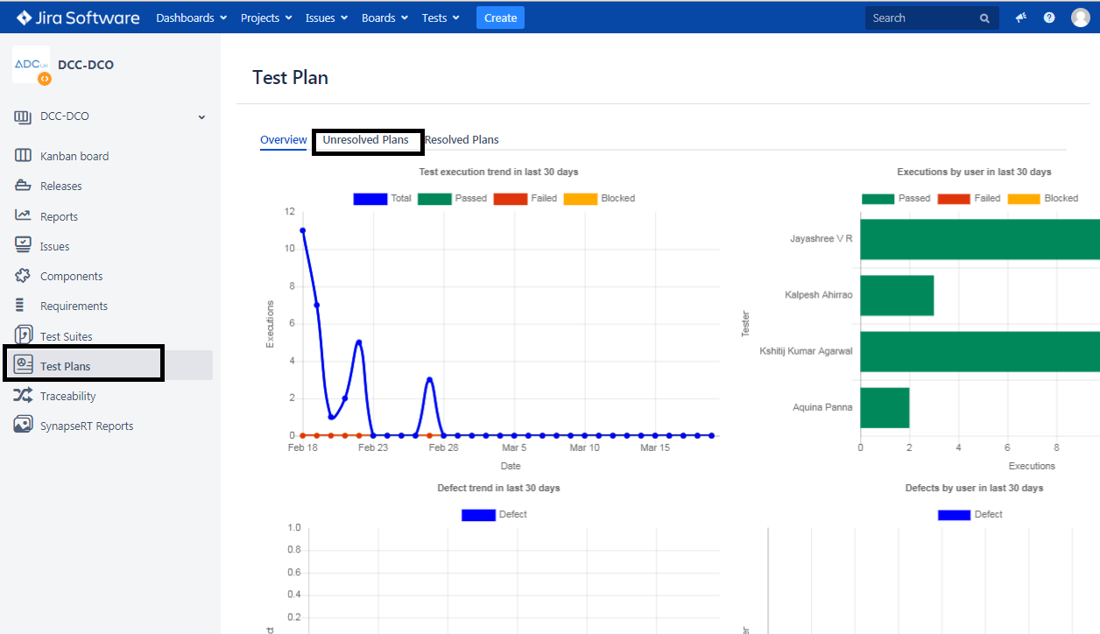
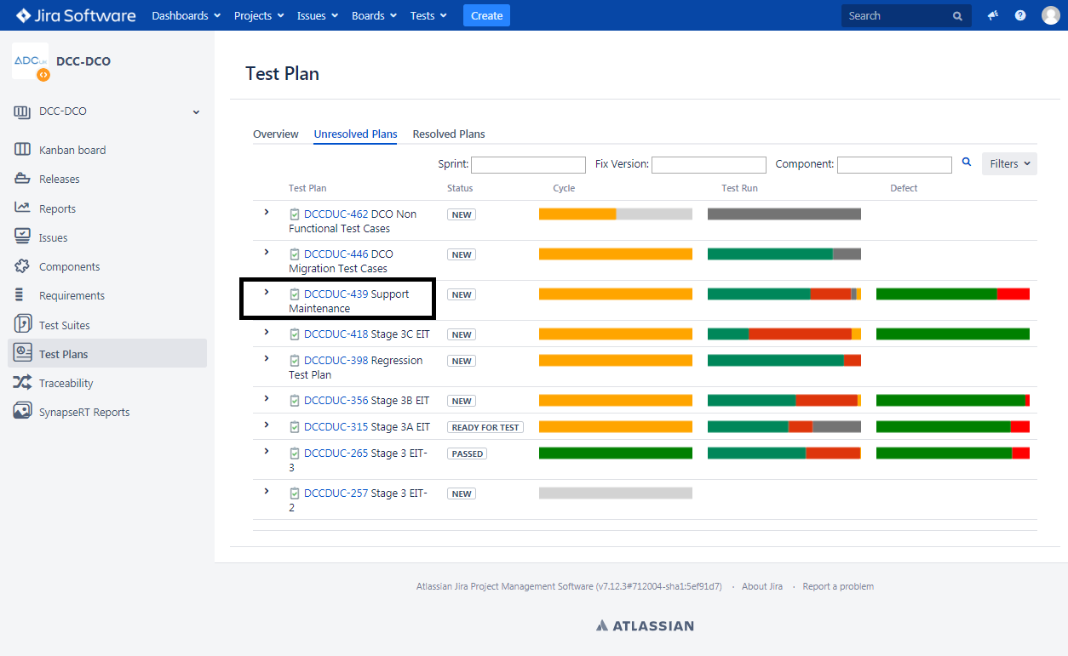
Execution Process
Execution is done by running the specific SR in guacamole and accordingly we pass and fail the test cases in JIRA.
Under the test plan go to unresolved plans.
Select a particular Test Plan for e.g. :-Here I’ve
chosen DCCDUC-439-Support Maintenance.

Slide 12
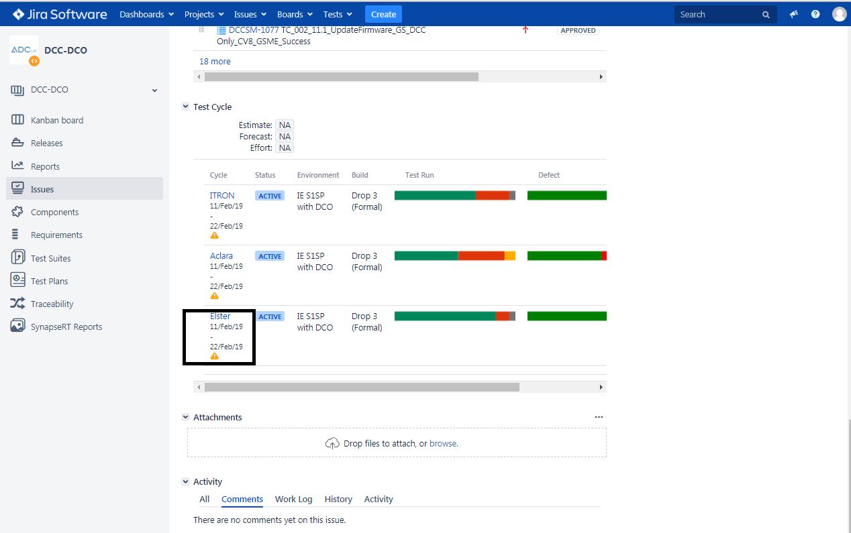
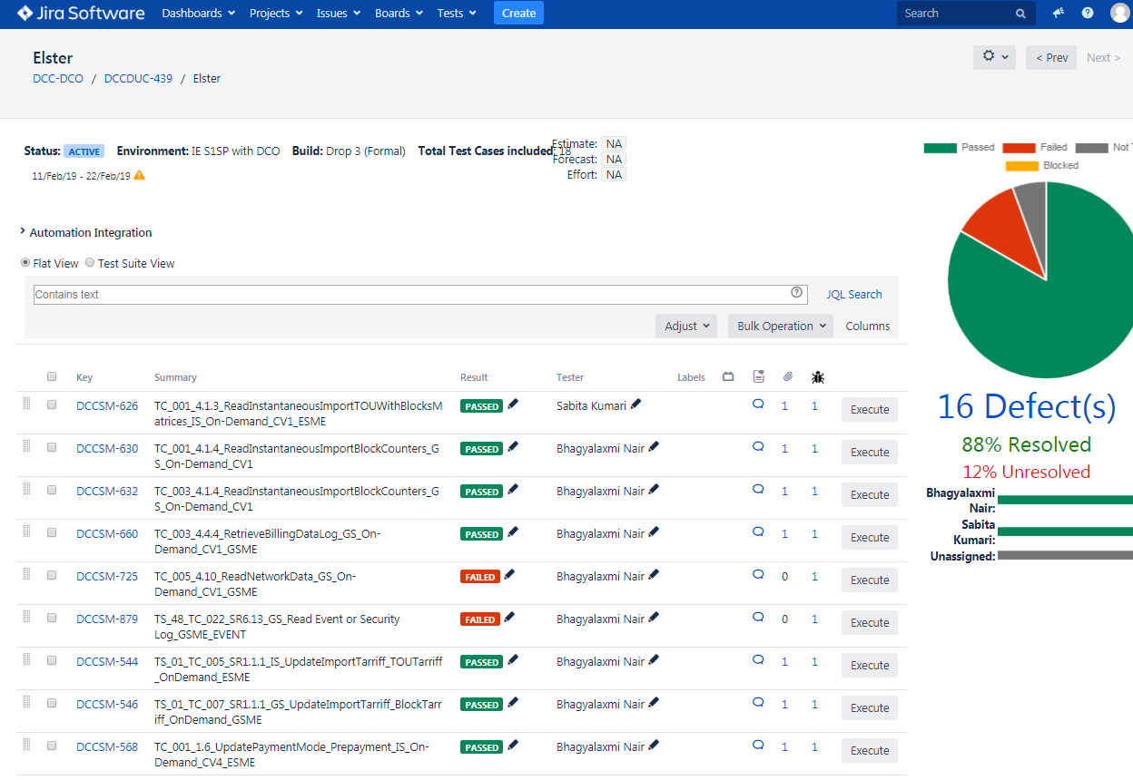
Execution Process
Under test cycle select any one cycle by clicking over it.
It will land you to the execution page of each and every SR where you can execute by updating the status as pass/fail.

Slide 13
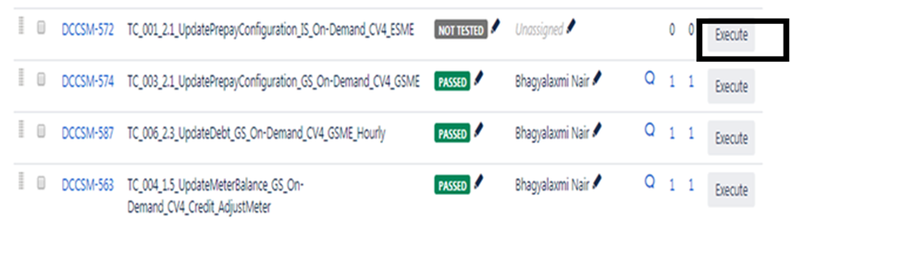
Execution Process
Click on the execute button.
Execute the test case and then add necessary comments and change the status to pass and fail accordingly.

Slide 14
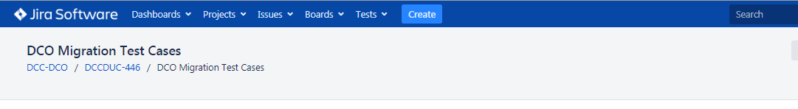
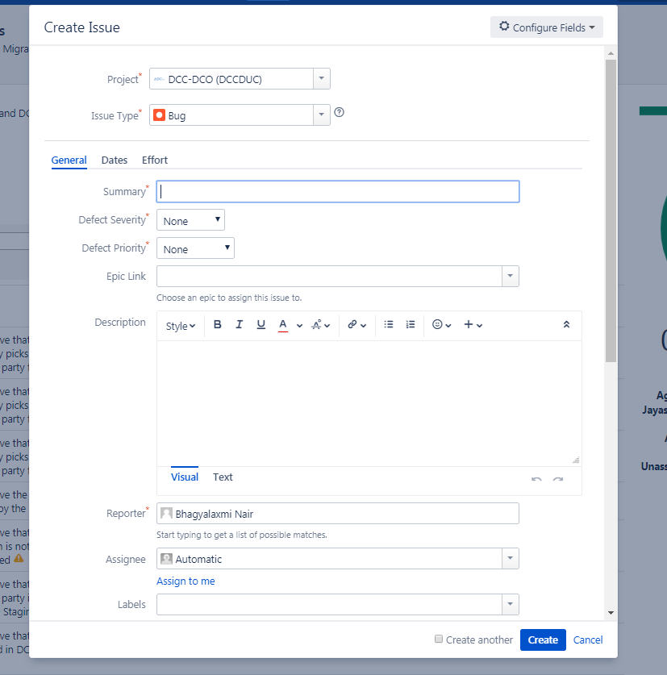
Defect Creation Process
Click on ‘Create’ located in the blue toolbar menu at the top of the screen.
Clicking on this will open a ‘Create Issue’ pop-up.

Slide 15
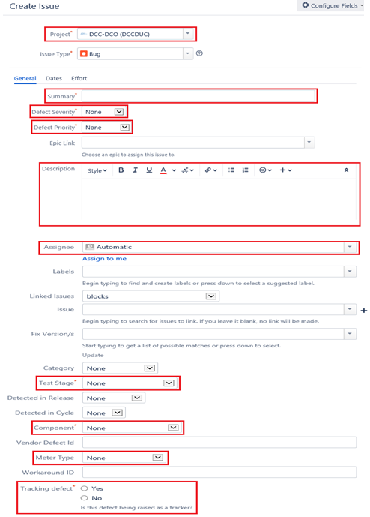
Defect Creation Process
The below screenshot highlights the mandatory fields in red. These must be completed when creating a new defect in Jira.

Slide 16
Defect Creation Process
PROJECT – this field is automatically populated. Please ensure you are creating a defect in the correct Jira project.
SUMMARY – this field is used to summarize the defect being raised and should only contain the following information: manufacturer, type and SRV. If needed, the attribute method ID may also be included.
DEFECT SEVERITY – this is a scale indicating the extent to which the defect will impact the whole project.
DEFECT PRIORITY – this is a scale indicating the extent to which the defect will impact the testing process.
DESCRIPTION – this should contain the following information: prerequisites, steps to reproduce defect, expected outcome, actual outcome and any other information required, such as whether the defect is being raised in Jira for tracking purposes.

Slide 17
Defect Creation Process
ASSIGNEE – when creating a new defect, please ensure that the Assignee is set to the Defect Manager and is not left as ‘Automatic’ or Unassigned’.
TEST STAGE – please choose the test stage at which the defect is occurring.
COMPONENT – this is the area of the system that is affected by the defect. This must always be set to ‘Undetermined’ when raising a new defect.
METER TYPE – this is the manufacturer and type of meter tested when the defect occurred.
TRACKING DEFECT – if the defect is being raised for tracking purposes, please ensure ‘Yes’ is selected against this field.
Once all these fields have been completed, click on the blue ‘Create’ button situated at the bottom right of the pop-up. This will create your new defect in Jira.

Slide 18
Defect Creation Process
Golden Rules
Ensure the Summary field only contains the following: Meter Manufacturer, Meter Type, SRV and Attribute Method ID if needed.
Ensure the Description field contains as much detail as possible on what you were doing when you found the defect so that it is possible for someone to recreate the error by following the description in the defect. Ideally screenshots should be attached.
Ensure the Component field is set to Undetermined.
New defects must always be assigned to Defect Manager and not left as Unassigned or Automatic.
Always add any email content which may suggest a solution or further clarification to the comments box so that the history of the defect is maintained.
When assigning an open defect to another member of the team, please write a comment detailing why you are assigning the defect to them so that they are aware of what actions they are expected to complete.
Please do not edit comments. If you wish to change information within a comment that has already been added, write a new comment detailing the new updates you wish to add to the defect.
When the defect is ready to be closed, please write the root cause of the defect in the comments box and inform Defect Manager. Only Defect Manager should close defects in Jira.

